Slide 1
The Nervous System: A Basic Blueprint
chapter 1

Slide 2
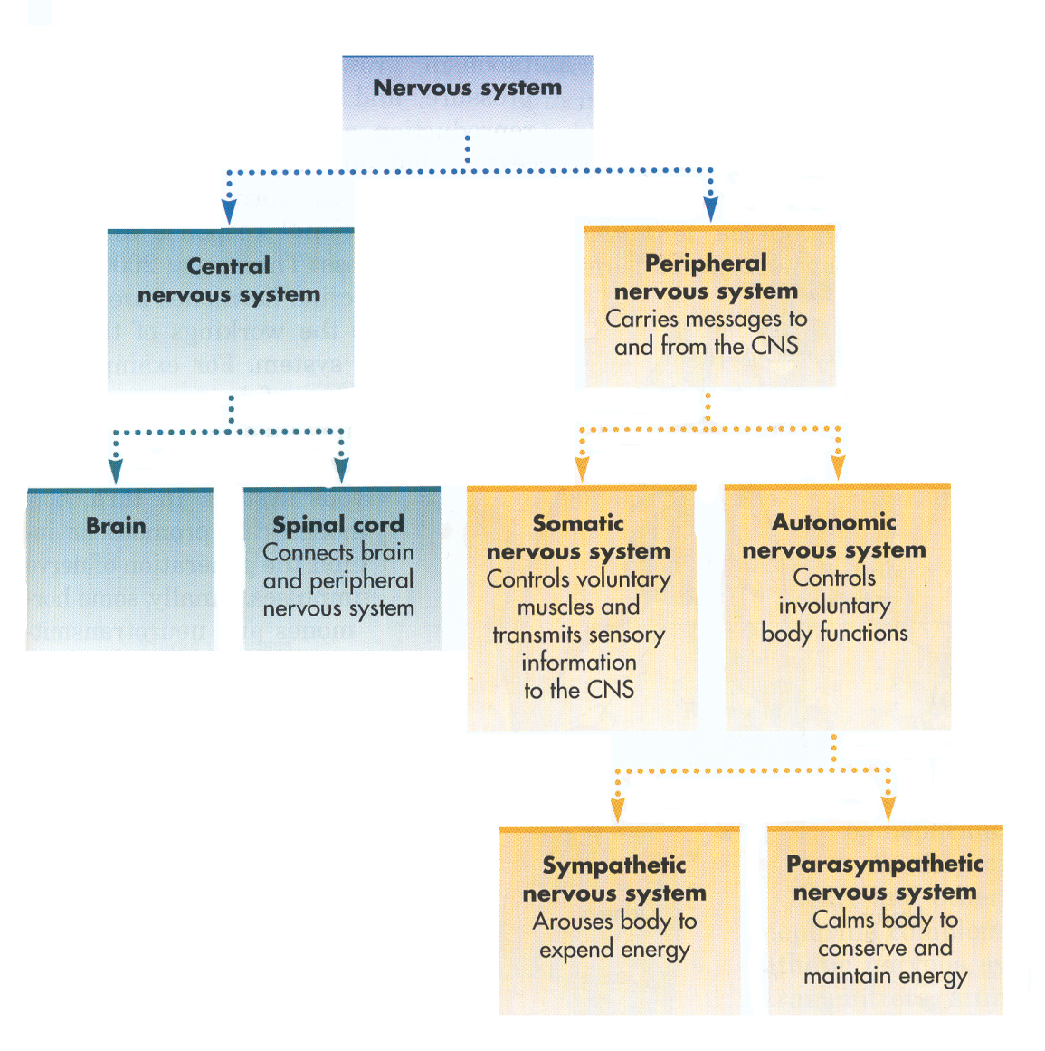
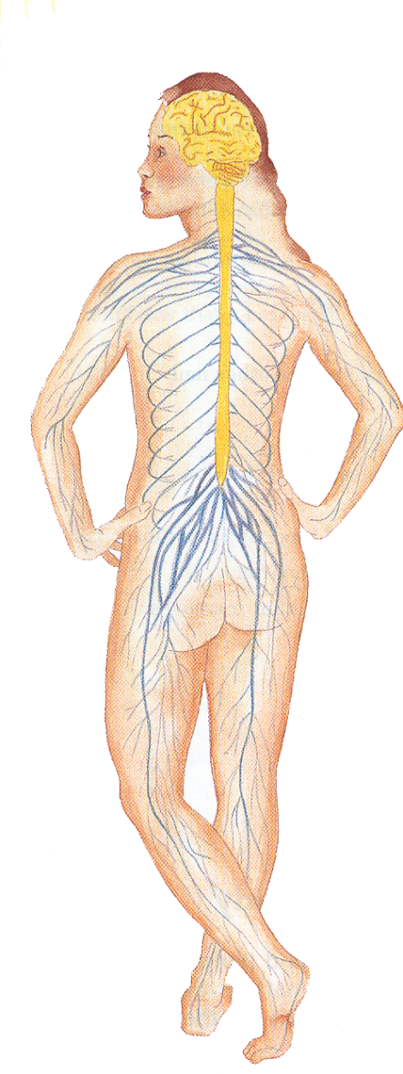

Slide 3
Function of the Nervous System?
Two main parts of the nervous system?

Slide 4
The Central Nervous System
Central Nervous System- Define
Parts- 1)
2)
Spinal Cord- Define
Spinal Column- Define
Spinal Reflexes- Define
Example

Slide 5
The Peripheral Nervous System
Peripheral Nervous System- Define
Sensory Nerves- Define
Motor Nerves- Define

Slide 6
Divided into 2 Parts-1)Name, Define and Example
2)Name, Define, and Example
Divided into 2 Parts-1) Name and Define
2) Name and Define
How do they work together?

Slide 9
Communication in the Nervous System

Slide 10
Neuron- Def
Glia- Def
Neurons often called?
Estimated amount of neurons?

Slide 11
The Structure of the Neuron

Slide 12
The Structure of the Neuron
3 main parts?
Dendrites- Def
Cell Body-Def
Axon- Def
Axon Terminals-Def
Neurons 2 jobs?
Myelin Sheath
2 jobs?
Nerves- Def

Slide 13
The Structure of the Neuron

Slide 14
Neurons in the News
Regeneration- Explain
Do mammals produce new CNS cells?
Stem Cells- Def
What can promote the production of new cells?
What can hurt?
Debate on Stem Cell Research?
Besides embryo’s where do they get stem cells?

Slide 15
How Neurons Communicate

Slide 16
How Neurons Communicate
Synaptic Cleft- def
Synapse- Def
When do they form?
What should a parent do to help?
How long does forming and pruning last?
Plasticity- Def
Action Potential- Def
Explain unmyelinated-
Example
Explain myelinated-

Slide 17
How Neurons Communicate
Synaptic Vessels- Def
Explain
Neurotransmitter- Def
Receptor Sites- Def
Effects
Excitatory- Def and Explain
Inhibitory- Def and Explain

Slide 18
How Neurons Communicate

Slide 20
Chemical Messengers in the Nervous System
1) Neurotransmitters: Versatile Couriers
Where do they exist?
What can they affect?
More well known neurotransmitters:
Serotonin-Explain
Dopamine- Explain
Acetylcholine- Explain
Norepinephrine- Explain
GABA- Explain
Glutamate
Name 3 problems that can occur and why?
What do they warn you about? Why?

Slide 21
2) Endorphins: The Brains Natural Opiates
Endorphins- Def
What roles do they Play?
Who discovered them?
When do endorphins “shoot up?”
What does this give animals? Give examples?

Slide 22
3) Hormones: Long-Distance Messangers
Hormones- Def
Endocrine Glands- Def
How do they work?
Examples of Hormones
a) Melatonin- Explain
b) Adrenal Hormones- Explain
Cortisol- Explain
Epinephrine- Explain
Norepinephrine- Explain
How can it improve memory? Give Example

Slide 23
c) Sex Hormones- Explain
Androgens- Explain
Estrogens- Explain
Progesterone- Explane

